Slide 1
Transmission Cryo-Electron Microscopy
A tool used by structural biologists to study
molecular nanomachines
Gabriel Lander, Thesis Defense 2009

Slide 2
This plastic tube contains our
molecular sample of interest
Inside the tube, the nanoparticles are freely mobile.
The sample must be frozen in order to image it

Slide 3
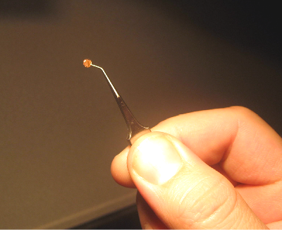
A tiny drop of the sample is
placed onto a copper grid
3mm

Slide 4
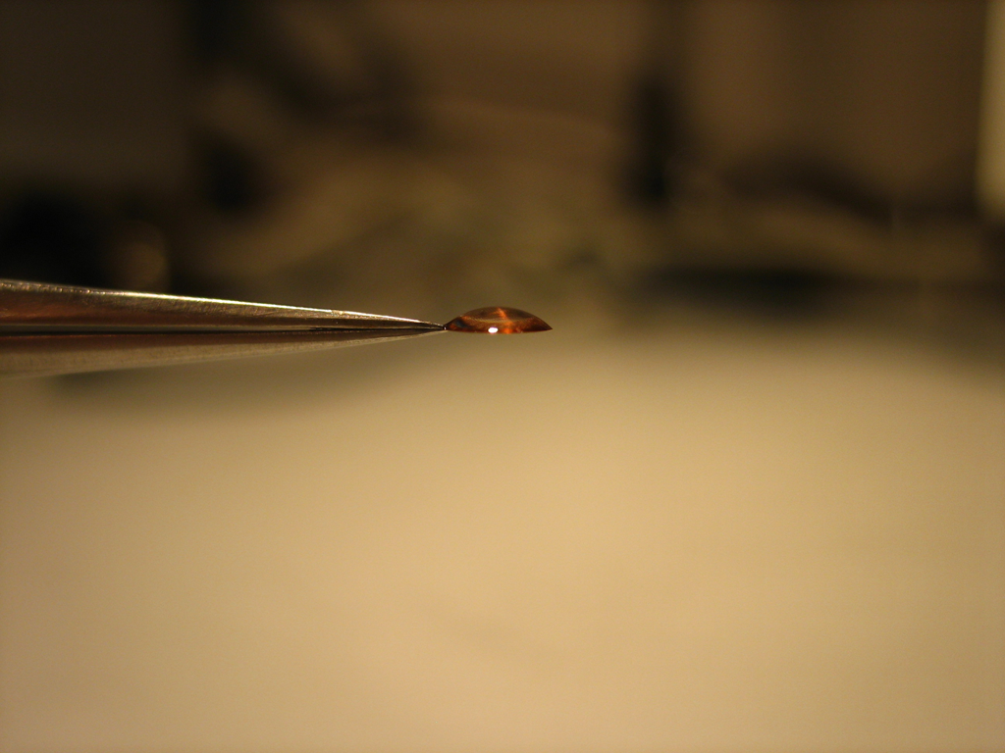
A tiny drop of the sample is
placed onto a copper grid
3 microliters of sample
side-view of grid

Slide 5
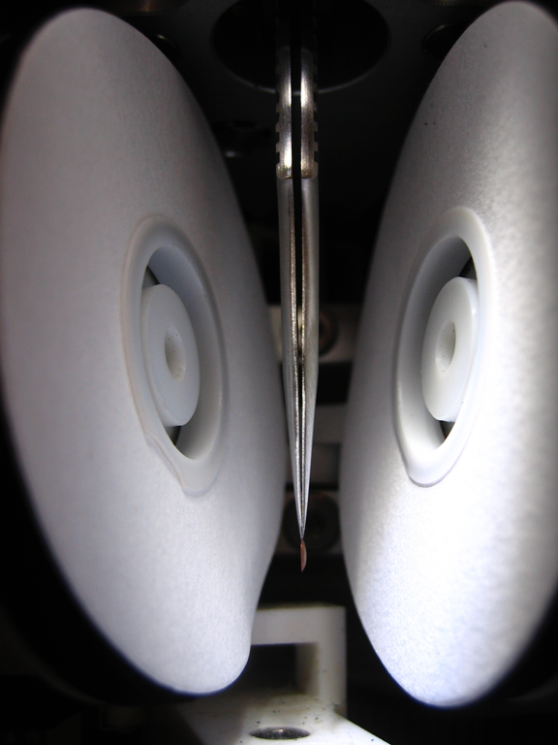
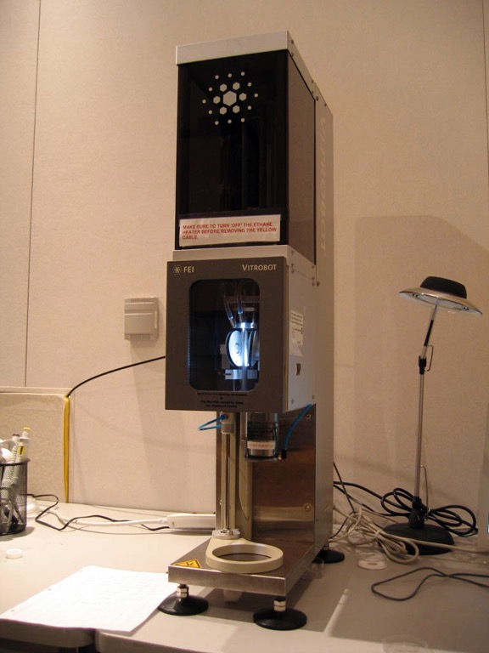
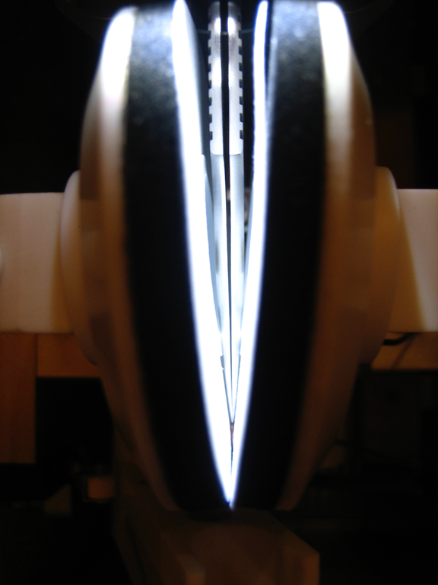
The sample is loaded into a machine called a Vitrobot
There are two blotting papers
on either side of the sample
this chamber maintains
100% humidity and a
temperature of 4ºC
They close on the grid and
leave a very thin layer of
molecules in solution

Slide 6
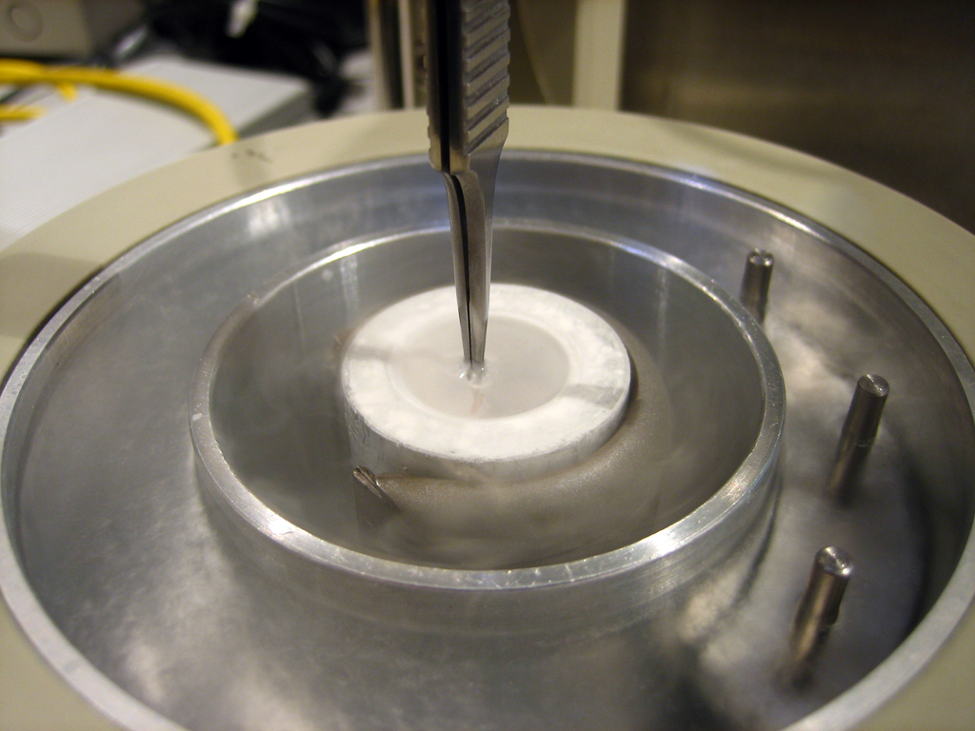
The sample is then quickly plunged into liquid ethane
Liquid Nitrogen
Liquid Ethane
the sample freezes so fast that ice crystals can’t form - this is called “vitreous” ice

Slide 7
That is how we go from sample in solution...
...to molecules frozen in thin ice

Slide 8
The grid containing the frozen molecules is loaded into an electron microscope
Now we can reconstruct a 3D structure from the frozen molecules

Slide 9
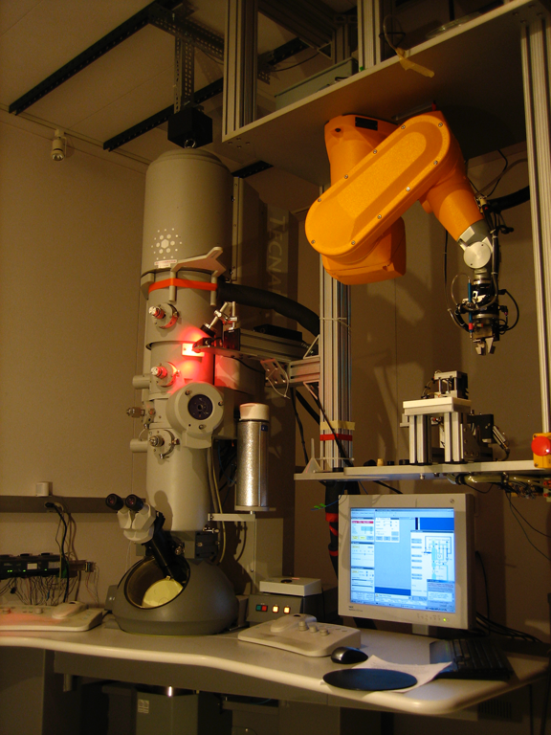
This is an example of a transmission
electron microscope (TEM)
FEI Tecnai F20

Slide 10
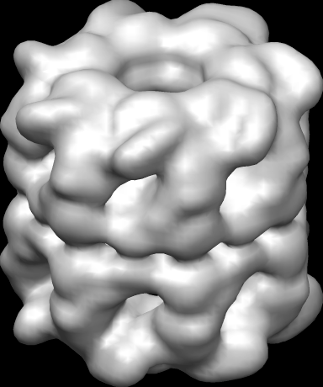
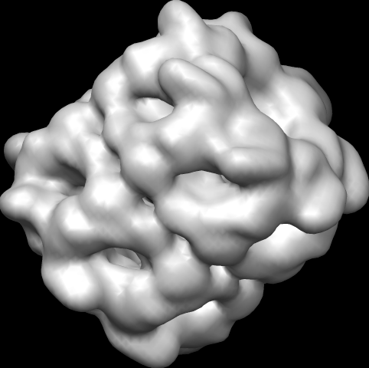
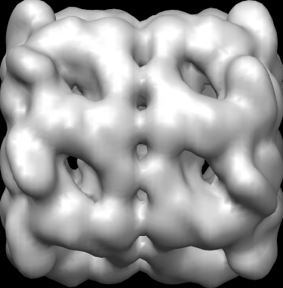
Here are three molecules trapped in different orientations
Underneath is a detector (such as photographic film)

Slide 11
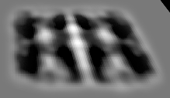
When we shoot the molecules with an electron beam, the orientation of the particles leaves a unique “shadow”
These “shadows” contain all the 3-dimensional information of the molecule, compressed into a 2D image

Slide 12
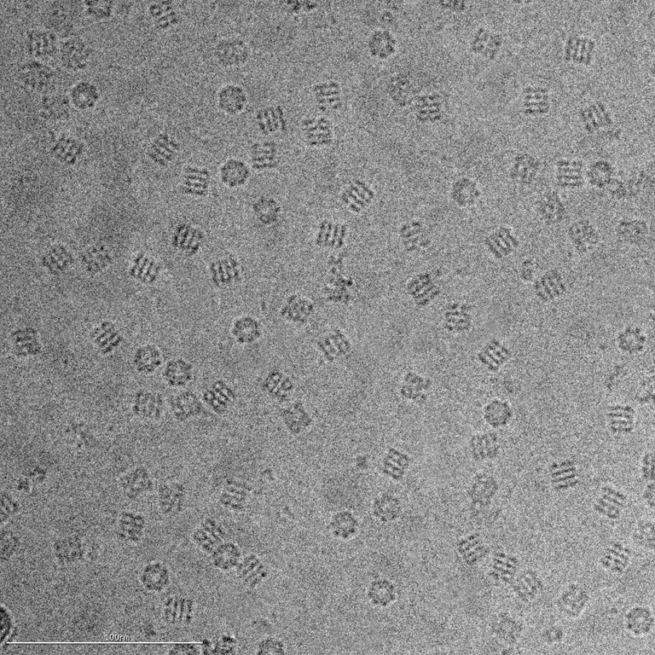
This is an example of an image we collect using the electron microscope
We can see the molecules as they are trapped in the ice, in different orientations

Slide 13
Even though the image is noisy, we can see that some of the particles are trapped in the same orientation
We can select these molecules and cut them out of the image

Slide 14
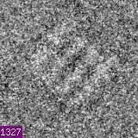
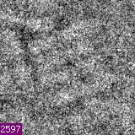
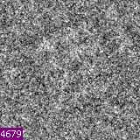
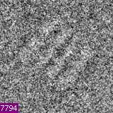
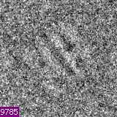
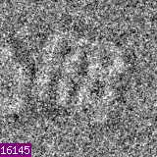
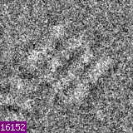
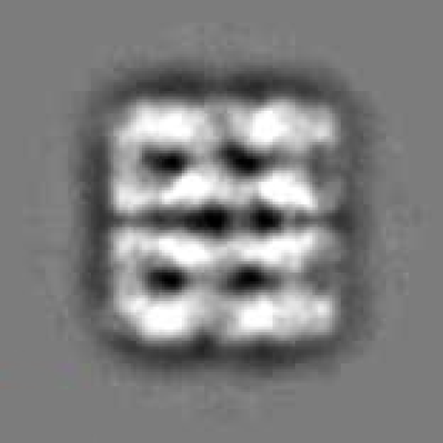
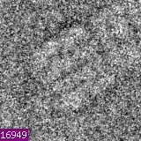
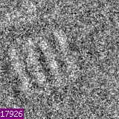
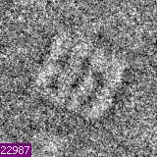
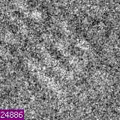
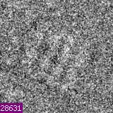
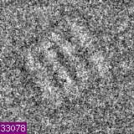
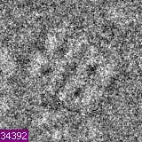
The contrast of the cut-out molecules is inverted
This summed image provides a more detailed view of the molecule in this orientation
Although the raw data is noisy, we can rotate them so that all the molecules are in the same orientation
These “aligned” molecules are then added together

Slide 15
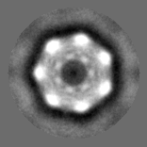
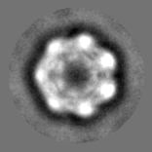
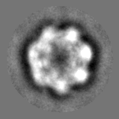
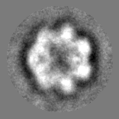
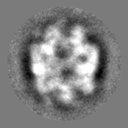
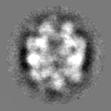
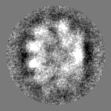
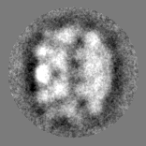
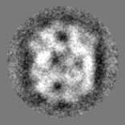
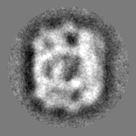
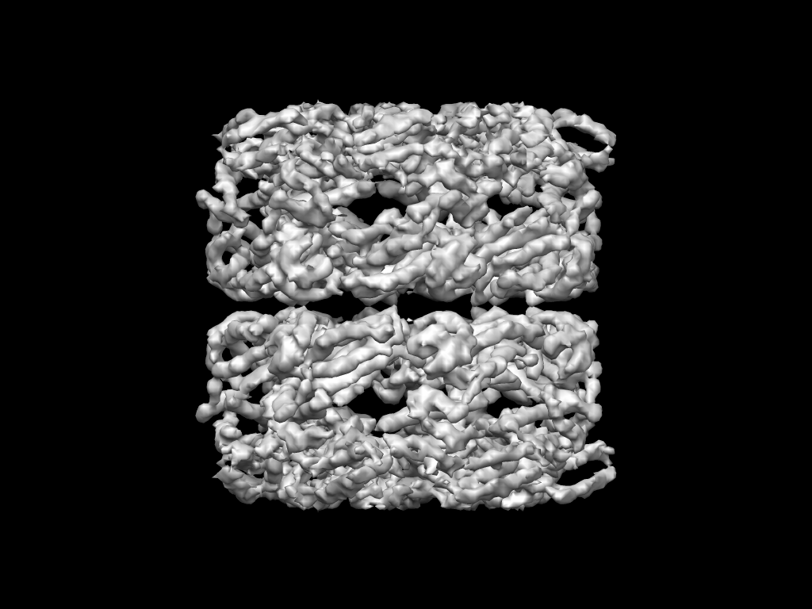
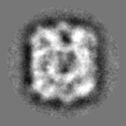
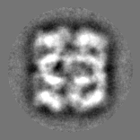
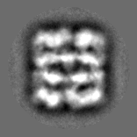
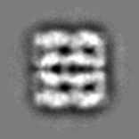
We perform this same process for the different orientations of the molecule
Then we gather all these views and combine them computationally

Slide 16
Then we gather all these views and combine them computationally
This provides us with a 3D reconstruction of our molecule

Slide 17
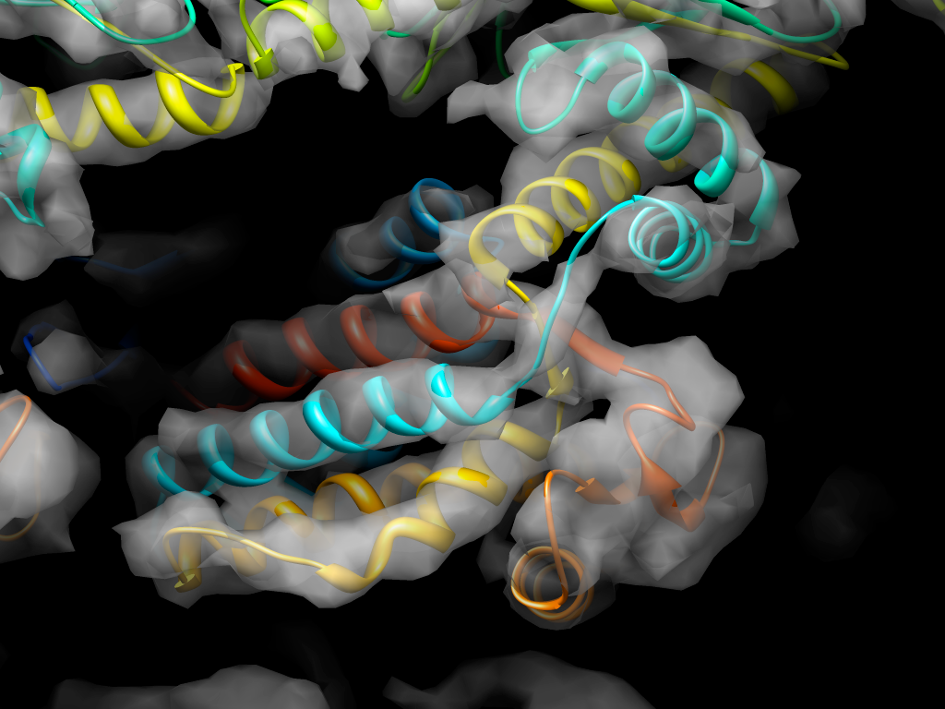
Zooming in, we can see structural features that tell us how the molecule functions in the cell

